Slide 1
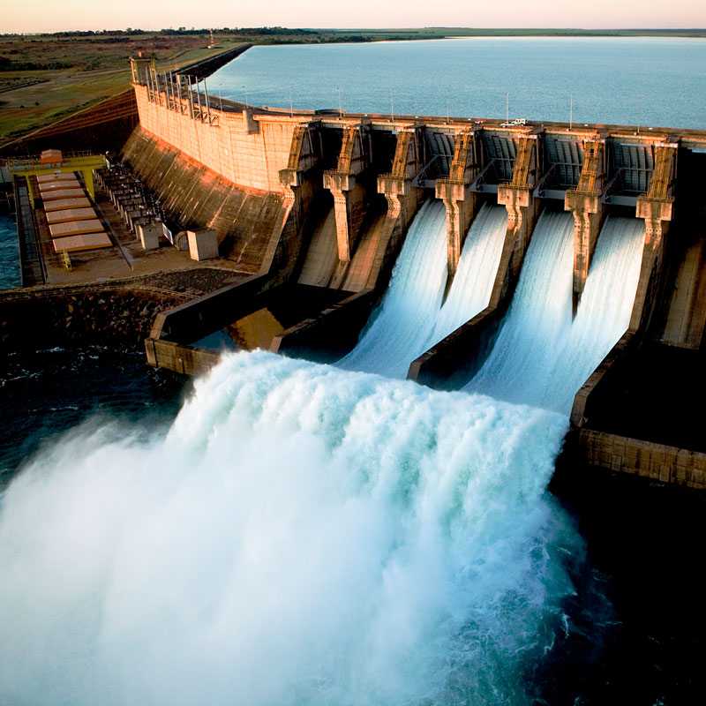


PhD Final Examination
Enhancing the Performance of
Country-Scale Water-Energy Systems through Synergized Operations
by Rachel Koh
under the guidance of Assoc. Prof. Stefano Galelli
21 June 2023
Notes:
Introduce elements of title:
Goals of power system: reliability, sustainability
Energy supply sector 2nd largest emitter of GHG
Transition to renewable sources → Intro hydropower, water-energy systems

Slide 2
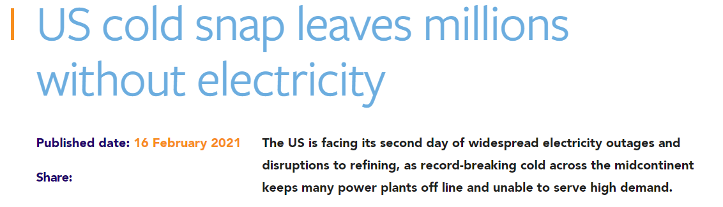
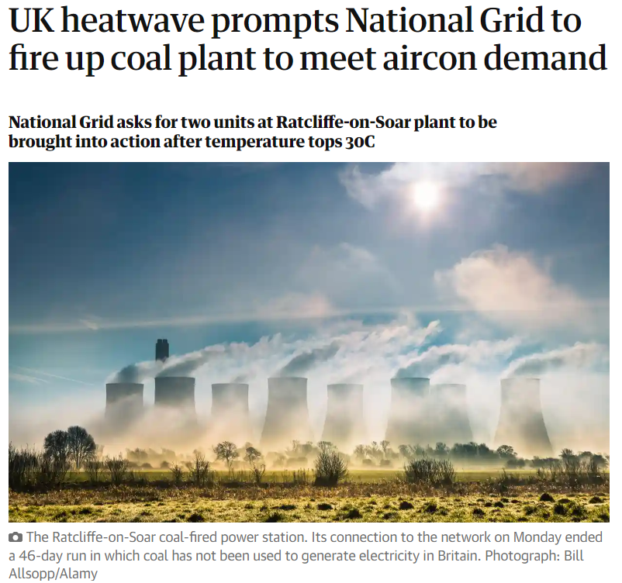


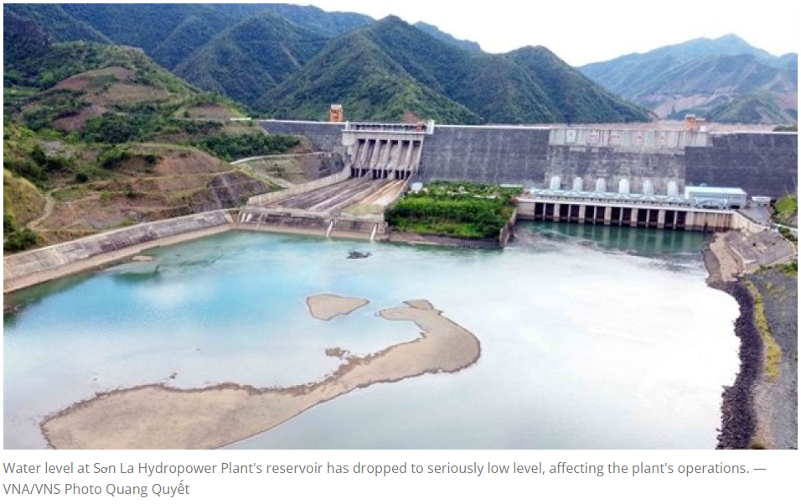





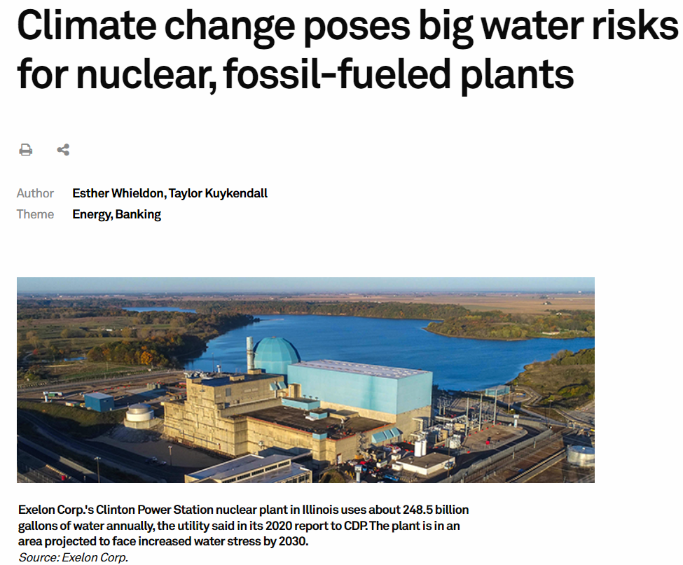



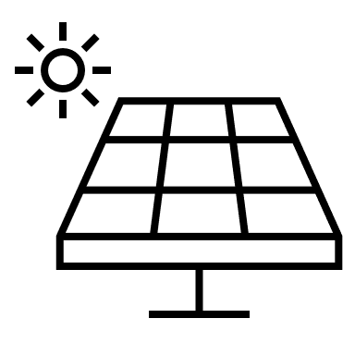
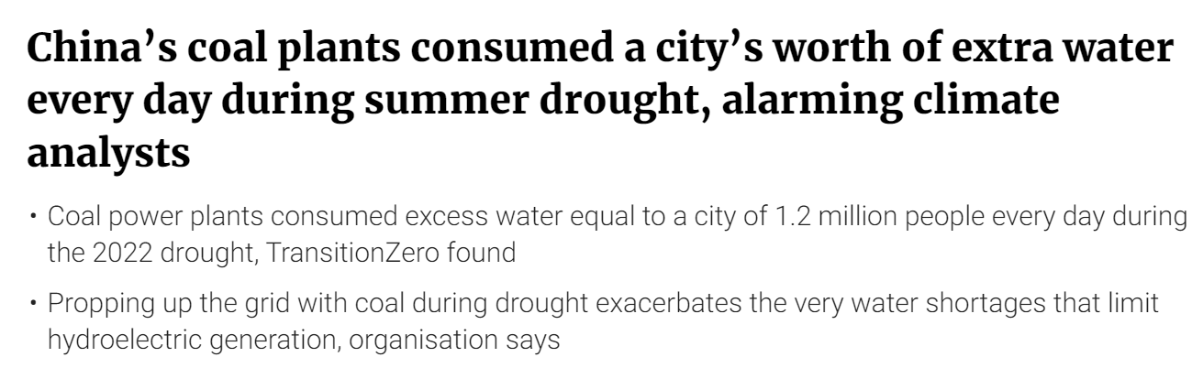
https://www.argusmedia.com/en/news/2187425-us-cold-snap-leaves-millions-without-electricity
Energy supply sector 2nd largest emitter of GHG
https://www.theguardian.com/environment/2023/jun/12/uk-heatwave-prompts-order-to-fire-up-coal-plant-to-meet-aircon-demand
https://asianews.network/severe-drought-affects-electricity-production-of-northern-hydropower-plants/
https://www.spglobal.com/marketintelligence/en/news-insights/latest-news-headlines/climate-change-poses-big-water-risks-for-nuclear-fossil-fueled-plants-60669992
https://www.scmp.com/business/article/3201057/chinas-coal-plants-consumed-citys-worth-extra-water-every-day-during-summer-drought-alarming-climate
Notes:
Texas temp as low as -14 degC
pipes froze and burst

Slide 3
Research Gaps & Contributions
Temporal scale
Years
SUB-TOPIC 2 (Chapter 3 in thesis)
Diagnosing Power Development Plans through Short-term Grid Operations
Capacity expansion plans lack detailed planning
Planning
SUB-TOPIC 1 (Chapter 2 in thesis)
Advancing the Integration of Renewables by Co-Simulating Water and Energy Systems
Days
Operations
Water management model
Power
system
model
Hours
Spatial scale
Country
SUB-TOPIC 3 (Chapter 4 in thesis)
Evaluating Streamflow Forecasts in Hydro-Dominated Power Systems — When and Why They Matter

Slide 4
SUB-TOPIC 1 (Chapter 2 in Thesis)
Advancing the integration of renewables by co-simulating
water and energy systems
In collaboration with Dr. Jordan Kern (North Carolina State University)
Koh, R., Kern, J. & Galelli, S. (2022). Hard-coupling water and power system models
increases the complementarity of renewable energy sources. Applied Energy 321,119386.
https://doi.org/10.1016/j.apenergy.2022.119386.

Slide 5
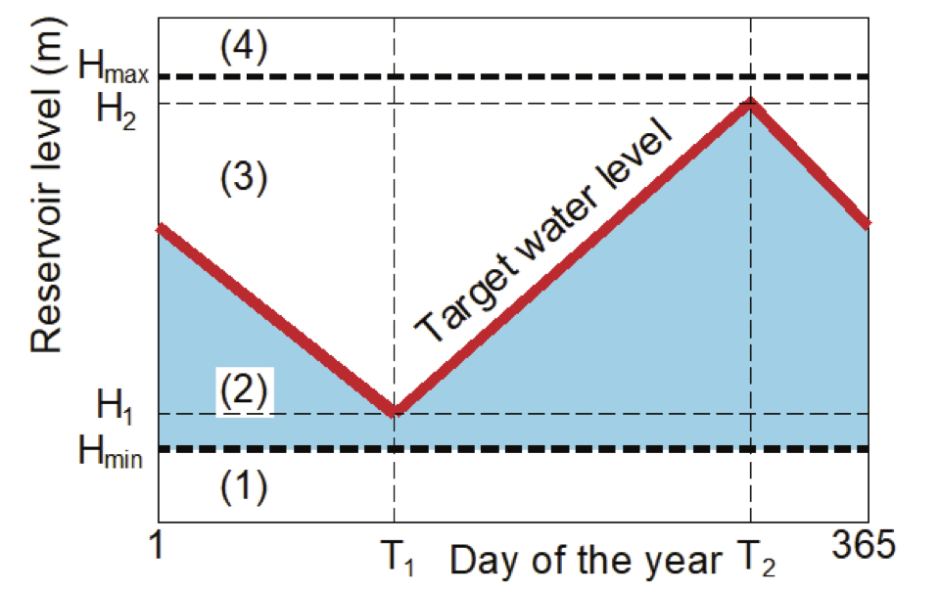
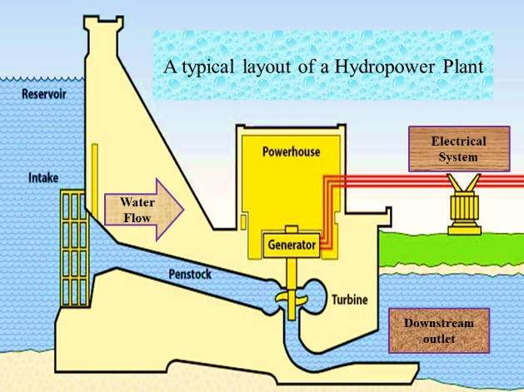
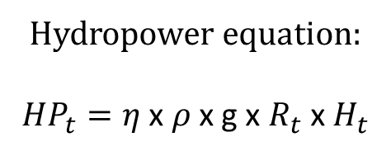
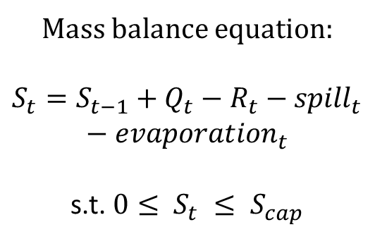
Reservoir Operations
Influence of
water
on
energy supply
Hydropower produced from turbine
Hydropower equation:
${HP}_{t}=η$ x $ρ$ x g x $R_{t}$ x $H_{t}$
Controlled release from reservoir
Storage at time t
Inflow to reservoir
Water density
Hydraulic head
Mass balance equation:
$S_{t}=S_{t−1}+Q_{t}−R_{t}−{spill}_{t}$ $−{evaporation}_{t}$
s.t. $0≤ S_{t} ≤ S_{cap}$
Turbine efficiency
Min, Ho & Wagh, Sumit & Kadier, Abudukeremu & Gondal, Irfan & Azim, Nur & Mishra, Mukesh. (2018).
Renewable Energy Technologies.

Slide 6
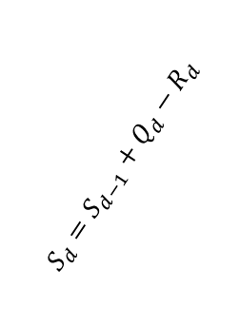
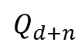
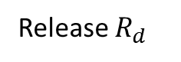
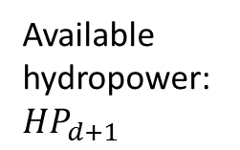
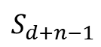

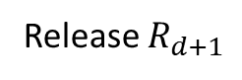
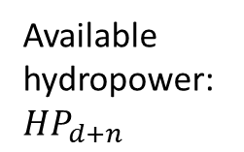
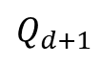
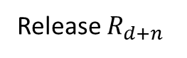
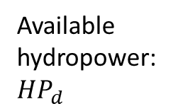
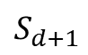
Traditional simulation environment
Day d
Day d+1
Day d+n
$$Q_{d}$$
$$S_{d−1}$$
Reservoir model
$$Q_{d+1}$$
Reservoir model
$$Q_{d+n}$$
Reservoir model
Water system
…
$$S_{d}=S_{d−1}+Q_{d}−R_{d}$$
Release $R_{d}$
Release $R_{d+1}$
Release $R_{d+n}$
$$S_{d+1}$$
$$S_{d+n−1}$$
Available hydropower: ${HP}_{d}$
Available hydropower: ${HP}_{d+1}$
Available hydropower: ${HP}_{d+n}$
Energy system

Slide 7
Power System Operations
Power system model (MILP)
Goal: Supply all demands at minimum cost, while complying with the technical constraints of the transmission network
Which generators should be used?
How much should each generator generate?
Unit Commitment
Economic dispatch
Integer variables
Continuous variables
On
Fixed costs
Variable costs
Switch
Start-up cost
Shut-down cost
Production
Fuel costs
Imports
Import costs

Slide 8

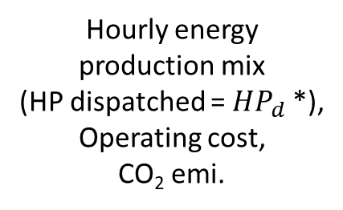

Traditional simulation environment
State-of-the-art simulation environment
Day d
Day d+1
Day d+n
$$Q_{d}$$
$$S_{d−1}$$
Reservoir model
$$Q_{d+1}$$
Reservoir model
$$Q_{d+n}$$
Reservoir model
Water system
…
$$S_{d}=S_{d−1}+Q_{d}−R_{d}$$
Release $R_{d}$
Release $R_{d+1}$
Release $R_{d+n}$
$$S_{d+1}$$
$$S_{d+n−1}$$
Available hydropower: ${HP}_{d}$
Available hydropower: ${HP}_{d+1}$
Available hydropower: ${HP}_{d+n}$
Power system model
Power system model
Power system model
…
Energy system
Hourly energy production mix
(HP dispatched = ${HP}_{d}$*),
Operating cost,
CO₂ emi.
Hourly energy
production mix
(HP dispatched = ${HP}_{d+1}$*),
Operating cost,
CO₂ emi.
Hourly energy
production mix
(HP dispatched = ${HP}_{d+n}$*),
Operating cost,
CO₂ emi.

Slide 9
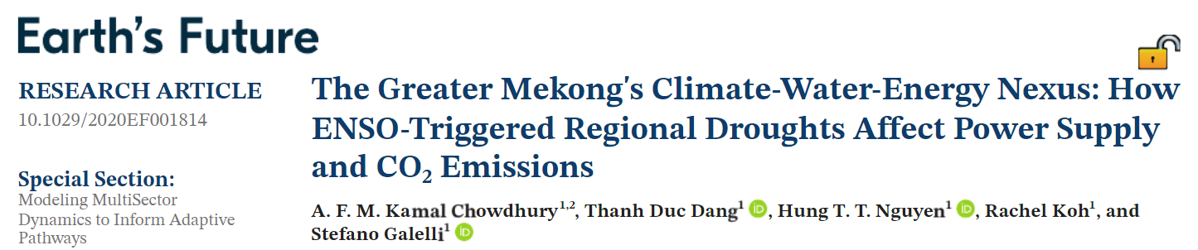
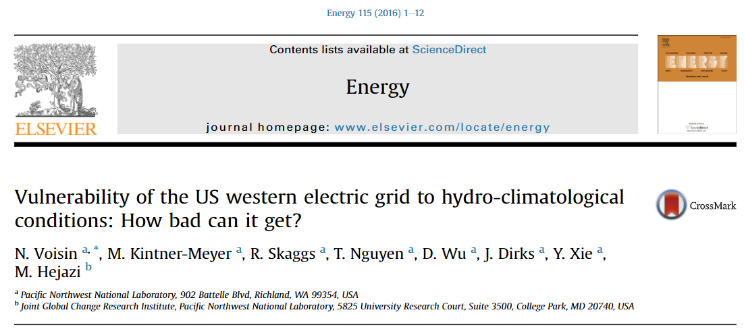

State-of-the-art simulation environment
9
Notes:
Example papers

Slide 10

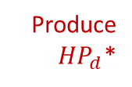

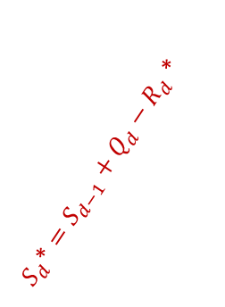
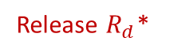
Co-
State-of-the-art simulation environment
Day d
Day d+1
Day d+n
What happens if ${HP}_{d}$* < ${HP}_{d}$?
Excess hydropower (${HP}_{d}−{HP}_{d}$*) curtailed (wasted)
Why do such events happen?
Variability in:
Energy demand
Seasonal
Temperature-driven
Supply
Reservoir inflow
Solar / wind
Physical constraints
Transmission line capacity
How can we improve the overall system performance?
$$Q_{d}$$
$$S_{d−1}$$
Reservoir model
$$Q_{d+1}$$
Reservoir model
$$Q_{d+n}$$
Reservoir model
Water system
$S_{d}\text{∗}=S_{d−1}+Q_{d}−R_{d}$ *
…
$$S_{d}=S_{d−1}+Q_{d}−R_{d}$$
Release $R_{d}$
Release $R_{d+1}$
Release $R_{d+n}$
$$S_{d+1}$$
$$S_{d+n−1}$$
Release $R_{d}$*
Produce
${HP}_{d}$*
Available hydropower: ${HP}_{d}$
Available hydropower: ${HP}_{d+1}$
Available hydropower: ${HP}_{d+n}$
Power system model
Power system model
Power system model
…
Energy system
Hourly energy production mix
(HP dispatched = ${HP}_{d}$*),
Operating cost,
CO₂ emi.
Hourly energy
production mix
(HP dispatched = ${HP}_{d+1}$*),
Operating cost,
CO₂ emi.
Hourly energy
production mix
(HP dispatched = ${HP}_{d+n}$*),
Operating cost,
CO₂ emi.
10

Slide 11
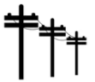
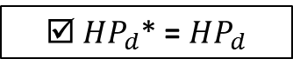
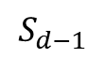
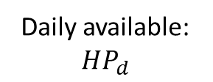

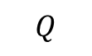

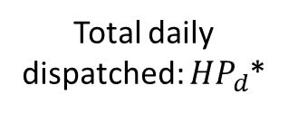
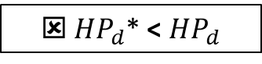
Modelling Framework
Release $R_{d}$*
Store $S_{d}$*
DAILY
$$S_{d−1}$$
implement
Reservoir re-operation model
$$Q$$
Reservoir model
☒ ${HP}_{d}$* < ${HP}_{d}$
No
Release $R_{d}$
Store $S_{d}$
implement
Yes
☑ ${HP}_{d}$* = ${HP}_{d}$
Stochastic inputs
Hydropower fully utilised?
Daily available: ${HP}_{d}$
HOURLY
oil
Total daily dispatched: ${HP}_{d}$*
Solar
Wind
Load
coal
Power system model
hourly
hydropower
other renewables
imports

Slide 12
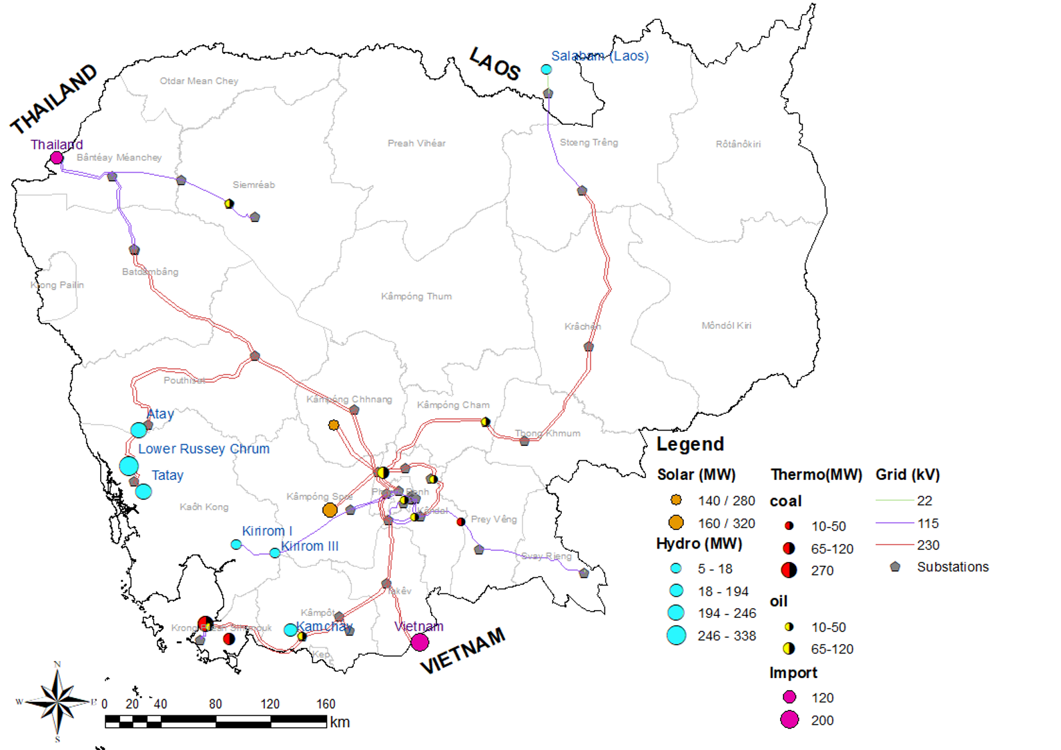
Study Site
Generating capacity as of 2016:
Hydropower: 1048 MW
Coal: 400 MW
Oil: 282 MW
Import from Vietnam: 200 MW
Import from Thailand: 120MW
Notes:
plot_hyd_solar_hr()

Slide 13




Synthetic data
Data | Source | Source
Solar irradiance |  | Renewables.ninja https://www.renewables.ninja/
Temperature |  | National Center for Atmospheric Research https://climatedataguide.ucar.edu/climate-data/climate-forecast-system-reanalysis-cfsr
Load |  | Electricite Du Cambodge EDC Annual Report, 2016
River discharge |  | Global Flood Awareness System https://cds.climate.copernicus.eu/cdsapp#!/dataset/cems-glofas-historical?tab=overview

Slide 14
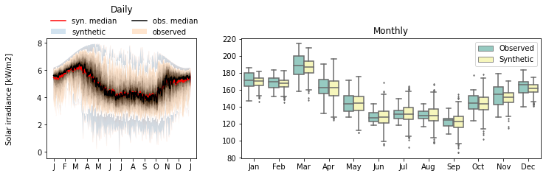
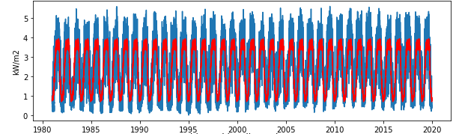
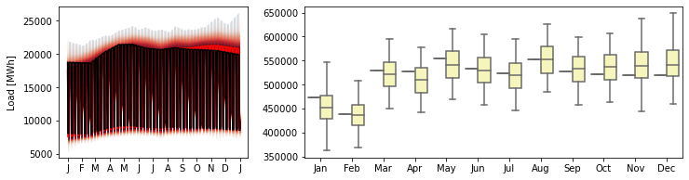
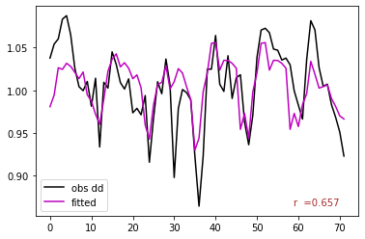
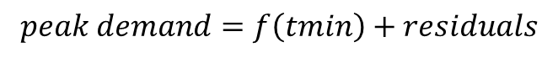
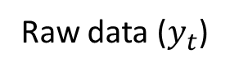
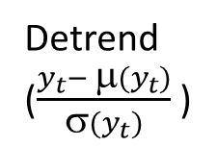
Synthetic data – Solar irradiance & Load
Raw data ($y_{t}$)
Synthetically expanded 1000-year time series
Detrend
($\frac{y_{t}− μ(y_{t})}{σ(y_{t})}$ )
Solar irradiance
Residuals
ARMA model
Load
$$peak demand=f\left(tmin\right)+residuals$$
Synthetic standardized residuals
Re-trend
Synthetically expanded time series

Slide 15

Synthetic data – Reservoir inflow
Daily streamflow time series for each reservoir
Kirsch-Nowak Streamflow Generator
Multi-site streamflow time series generator
Resolution: Daily
Accounts for correlation across sites
Rescales synthetic flows with monsoon
Kirsch-Nowak Streamflow Generator
Synthetic daily streamflow time series for each reservoir
Synthetically expanded 1000-year spatially-aggregated streamflow
time series
https://github.com/julianneq/Kirsch-Nowak_Streamflow_Generator

Slide 16
Goal: To understand the benefits of hard-coupling water and power system models (2 scenarios: with & w/o feedback)
Stationary hydro-meteorological uncertainty
Current and future grid
infrastructure
1000 synthetic
time series
3 grid
set-ups
6 scenarios x 1000 simulations each
Streamflow
Solar
irradiance
Load
As-is grid
+300MW
solar
+600MW
solar
Experimental setup
Case | 1 | 1H | 2 | 2H | 3 | 3H
Installed cap (MW) Coal Oil Hydro Solar | 400 602 1048 | 400 602 1048 | 400 602 1048 300 | 400 602 1048 300 | 400 602 1048 600 | 400 602 1048 600
Co-simulation |  | ✓ |  | ✓ |  | ✓
Performance metrics:
Annual cost
Annual CO₂ production
Renewable penetration

Slide 17

Probabilistic assessment
Cost savings: 4% - 40%
CO₂ reduction: 4% - 50%
Add. renewable: 1% - 20%
Co-operating is beneficial

Slide 18

Flexibility
Extent of benefits controlled by:
Streamflow
Load
Strong correlation btw cost & CO₂ emission

Slide 19
Conclusions
Co-simulation facilitates operational flexibility
Benefits:
Lower operating costs
Lower CO₂ emissions
More renewables usage
Favorable conditions:
High inflow
Low load

Slide 20
SUB-TOPIC 2 (Chapter 3 in Thesis)
Diagnosing Power Development Plans through Short-term Grid Operations
In collaboration with Dr. Jordan Kern (North Carolina State University)

Slide 21



Slide 22

 | 2016 | 2019 | 2022 | 2025
Peak demand (MW) Energy demand (GWh) | 1,068 6,612 | 1,755 11,738 | 3,455 15,456 | 4,828* 28,465*

Slide 23

Power development plans - Gaps
2025 demand nodes
Aggregated by province
Simplification
Demand
Supply
Transmission lines
Overlook
Operational constraints
Variability in supply and demand
Evaluate long-term plans using short-term grid operations

Slide 24

Experiments – Stress test
Synthetic reservoir inflow
(50 scenarios)
Synthetic load
(50 scenarios)
Water management model
Available hydropower
Power system model
Potential issues in future grid
Potential solutions
Management (Feedback)
Physical (Infrastructure)

Slide 25





2025 grid: Potential Issues

Slide 26


2025 grid: Potential Issues
Problem I: Transmission line stress
Problem II: Power shortage
Solution I: Management
Solution II: Physical

Slide 27


2025 grid: Management vs. Physical solution
Physical solutions are useful in reducing grid stress

Slide 28

2025 grid: Management vs. Physical solution
Management solution: Increases hydro usage, Reduces operating cost
Physical solution: Reduces power shortage

Slide 29
Conclusions
Grid expansion plans may overlook operational constraints
E.g., Transmission lines, Reserves requirements
Potential problems
E.g., Grid stress, Unfulfilled demand
Short-term operations should be used to diagnose long-term plans
Management solution: Increases HP usage, Reduces operating cost
Physical solution: Reduces grid stress, Reduces power shortage

Slide 30
SUB-TOPIC 3 (Chapter 4 in Thesis)
Evaluating Streamflow Forecasts in Hydro-Dominated Power Systems — When and Why They Matter
Koh, R., & Galelli, S. (2023). Evaluating Streamflow Forecasts in Hydro-Dominated Power Systems — When and Why They Matter. Water Resources Research. (in preparation)

Slide 31

Study Site
Generating capacity as of 2016:
Hydropower: 1048 MW
Coal: 400 MW
Oil: 282 MW
Import from Vietnam: 200 MW
Import from Thailand: 120MW

Slide 32
Assessing streamflow forecast value
System operating costs
Water shortage
CO₂ emissions
Reservoir Model
Available
hydropower
Available
hydropower
Power System Model
Spilled water volume
Energy generation mix
Deviation from pre-defined target
Transmission line usage

Slide 33
Transmission line details
Electricity demand
Thermal generator parameters
System operating costs
CO₂ emissions
Energy generation mix
Transmission line usage
Power System Model
Available
hydropower
Dispatched
hydropower
Available
hydropower
Reservoir
Re-operation Model
Target storage level
Inflow forecasts
Reservoir Model
Updated release

Slide 34
Reservoir Operations
Inflow to reservoir
Controlled release from reservoir
Storage
Mass balance equation: $S_{d}^{i}=S_{d−1}^{i}+Q_{d}^{i}−R_{d}^{i}−{spill}_{d}$ $−{evaporation}_{d}$
s.t. $0≤ S_{d} ≤ S_{cap}$
Hydropower equation: ${HP}_{d}^{i}=η$ x $ρ$ x g x $R_{d}^{i}$x${ H}_{d}^{i}$
Hydropower produced from turbine
Turbine efficiency
Water density
Hydraulic head
$$\max_{R_{d}^{i},R_{d+1}^{i},…,R_{d+H−1}^{i}}{\sum_{t=d}^{d+H−1}{{HP}_{t}^{i}−X(s_{t=d+H−1}^{i})}}$$
$$Q_{d}^{f,i}$$
$$Q_{d+H−1}^{f,i}$$
Streamflow forecast
d-1
d
day
d+H-1

Slide 35

Experiments
Global Flood Awareness System
https://cds.climate.copernicus.eu/cdsapp#!/dataset/cems-glofas-historical?tab=overview
Data: River discharge (obs & forecast)
Simulation period: 2000-2019 (19 years)
Forecast horizon: 30 days
Forecast scenarios:
Perfect forecast
Climatology
11 forecast members + Ensemble mean
Skill measure: Symmetric Mean Absolute Percentage Error (SMAPE)
Key performance metrics:
Available hydropower
Dispatched hydropower
Unused hydropower
System operating costs
CO₂ emissions
Number of N-1 violations
14 deterministic forecast scenarios x2
(with & w/o feedback)

Slide 36
Experiments
Global Flood Awareness System
https://cds.climate.copernicus.eu/cdsapp#!/dataset/cems-glofas-historical?tab=overview
Data: River discharge (obs & forecast)
Simulation period: 2000-2019 (19 years)
Forecast horizon: 30 days
Forecast scenarios:
Perfect forecasts
Climatology
11 forecast members + Ensemble mean
Skill measure: Symmetric Mean Absolute Percentage Error (SMAPE)
Key performance metrics:
Available hydropower
Dispatched hydropower
Unused hydropower
System operating costs
CO₂ emissions
Number of N-1 violations
14 deterministic forecast scenarios x2
(with & w/o feedback)
Scope of Analysis
Different operating schemes
No forecast vs. Perfect vs. Climatology vs. Ensemble mean
Forecasts with different skills
11 forecast members
Inclusion of operational flexibility (feedback)

Slide 37


Result I
Forecasts reduce hydropower over-production
Pre-monsoon: Feb-Apr
Post-monsoon: Nov-Jan
Monsoon: May-Oct
Sustained hydropower supply
Sustained hydropower supply
Hydropower production ≠ Hydropower dispatched

Slide 38



Forecasts most beneficial post-monsoon, but under-perform during the monsoon.

Slide 39

Result II
Skill-value relationship is partially masked by the value of Q.

Slide 40

Forecasts matter only in some specific moments and for some specific variables.
Performance is largely determined by the interactions between system components.

Slide 41
Conclusions
The use of streamflow forecasts improves system operations:
Reduces hydropower over-production during monsoon
Maintains hydropower supply post-monsoon
Reduces transmission line stress
Trade-offs between benefits during and after the monsoon
Performance is largely determined by the interactions between system components

Slide 42
Summary of Contributions
Research Gap
Resolution
Finding
Interactions between water-energy systems not represented
Hard-coupled water-energy models
- More efficient operations
- Better system performance
Sub-topic 1
Power development plans do not consider operational constraints
Run long-term power development plans at operational level
Short-term operations can identify potential issues in long-term plans
Sub-topic 2
Benefits of streamflow forecasts in power systems not demonstrated
Use power system metrics to assess the value of streamflow forecasts
Trade-off between benefits during and after the monsoon
Sub-topic 3

Slide 43
Future work
Speed up computation
Model interconnections between countries

Slide 44
Thank you!

Slide 46
References
Chowdhury, A. K., Dang, T. D., Nguyen, H. T., Koh, R., & Galelli, S. (2021). The Greater Mekong's Climate‐Water‐Energy Nexus: How ENSO‐Triggered Regional Droughts Affect Power Supply and CO2 Emissions. Earth's Future, 9(3), e2020EF001814. doi: 10.1029/2020EF001814
Chowdhury, A. K., Kern, J., Dang, T. D., & Galelli, S. (2020). PowNet: a network-constrained unit commitment/economic dispatch model for large-scale power systems analysis. Journal of Open Research Software, 8(1). doi: 10.5334/jors.302
Electricite Du Cambodge (2016). 2016 Annual Report. Technical Report, Electricite Du Cambodge
Gebretsadik, Y., Fant, C., Strzepek, K., & Arndt, C. (2016). Optimized reservoir operation model of regional wind and hydro power integration case study: Zambezi basin and South Africa. Applied Energy, 161, 574-582. doi: 10.1016/j.apenergy.2015.09.077
Harrigan, S., Zsoter, E., Alfieri, L., Prudhomme, C., Salamon, P., Wetterhall, F., C. Barnard, H. Cloke & Pappenberger, F. (2020). GloFAS-ERA5 operational global river discharge reanalysis 1979–present. Earth System Science Data, 12(3), 2043-2060. doi: 10.24381/cds.a4fdd6b9
Kahil, T., Parkinson, S., Satoh, Y., Greve, P., Burek, P., Veldkamp, T. I., ... & Wada, Y. (2018). A continental‐scale hydroeconomic model for integrating water‐energy‐land nexus solutions. Water resources research, 54(10), 7511-7533. doi: 10.1029/2017WR022478
Kelly, T. D., & Foster, T. (2021). AquaCrop-OSPy: Bridging the gap between research and practice in crop-water modeling. Agricultural Water Management, 254, 106976. doi: 10.1016/j.agwat.2021.106976
Kern, J. D., Patino-Echeverri, D., & Characklis, G. W. (2014). An integrated reservoir-power system model for evaluating the impacts of wind integration on hydropower resources. Renewable energy, 71, 553-562. doi: 10.1016/j.renene.2014.06.014
National Center for Atmospheric Research Staff (Eds). Last modified 08 Nov 2017. "The Climate Data Guide: Climate Forecast System Reanalysis (CFSR)." Retrieved from https://climatedataguide.ucar.edu/climate-data/climate-forecast-system-reanalysis-cfsr.
Pfenninger, S. & Staffell, I. (2016). Long-term patterns of European PV output using 30 years of validated hourly reanalysis and satellite data. Energy 114, pp. 1251-1265. doi: 10.1016/j.energy.2016.08.060
Staffell, Iain and Pfenninger, Stefan (2016). Using Bias-Corrected Reanalysis to Simulate Current and Future Wind Power Output. Energy 114, pp. 1224-1239. doi: 10.1016/j.energy.2016.08.068
Su, Y., Kern, J. D., Denaro, S., Hill, J., Reed, P., Sun, Y., Cohen, J., & Characklis, G. W. (2020). An open source model for quantifying risks in bulk electric power systems from spatially and temporally correlated hydrometeorological processes. Environmental Modelling & Software, 126, 104667. doi: 10.1016/j.envsoft.2020.104667
Vinca, A., Parkinson, S., Byers, E., Burek, P., Khan, Z., Krey, V., ... & Riahi, K. (2020). The NExus Solutions Tool (NEST) v1. 0: an open platform for optimizing multi-scale energy–water–land system transformations. Geoscientific Model Development, 13(3), 1095-1121. doi: 10.5194/gmd-2019-134
Voisin, N., Kintner-Meyer, M., Skaggs, R., Nguyen, T., Wu, D., Dirks, J., Xie, Y., & Hejazi, M. (2016). Vulnerability of the US western electric grid to hydro-climatological conditions: How bad can it get?. Energy, 115, 1-12. doi: 10.1016/j.energy.2016.08.059

